Slide 1
Lecture 2: Stratigraphic data
Boris Natalin

Slide 2
Data from surface outcrops
Subsurface data such as well logs, seismic data, and cores
Sedimentary rocks: Clastic (Siliciclastic) Biogenic Chemical

Slide 3
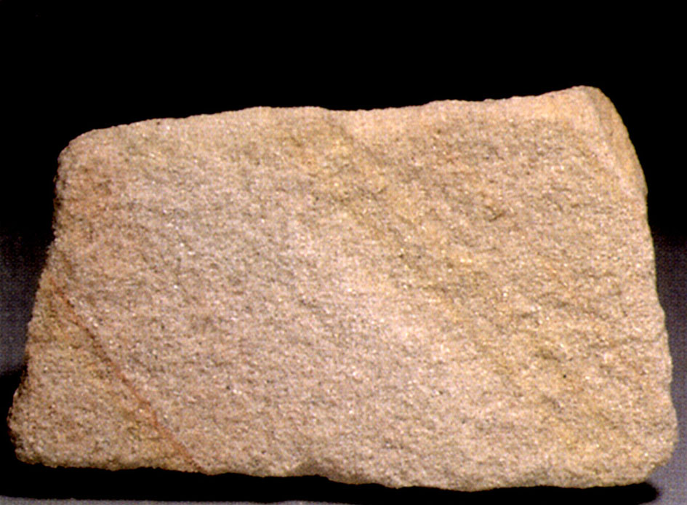
Sandstone
Clastic sedimentary rocks

Slide 4
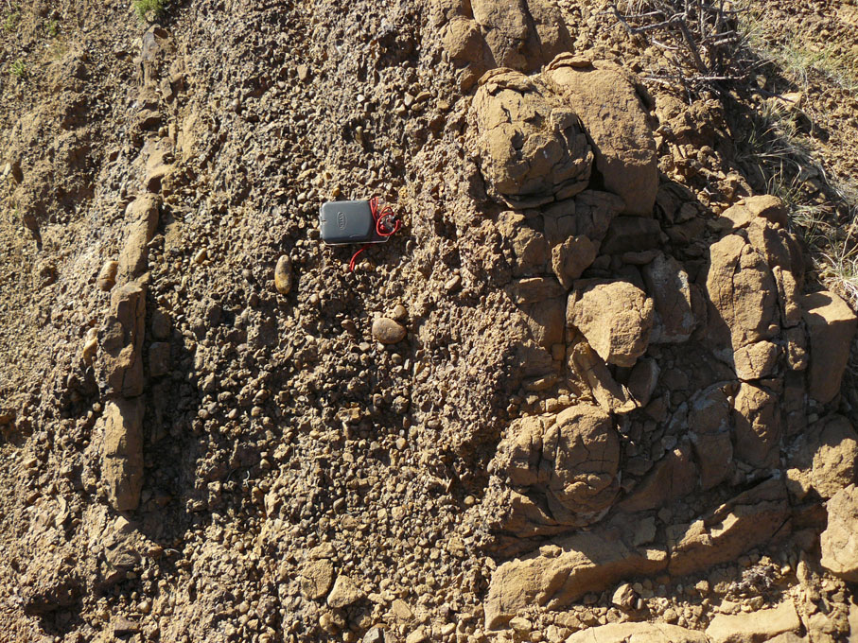

Slide 5
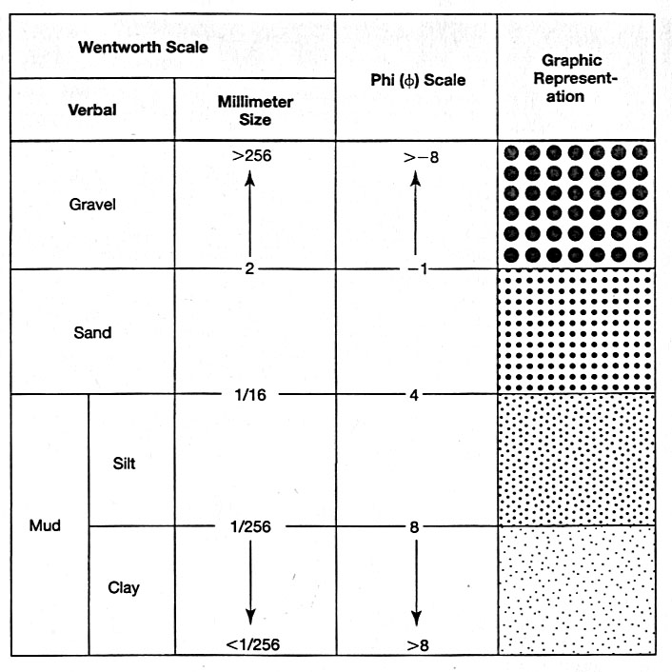
Classification
φ= -log2 diameter (in millimeters)

Slide 6
Classification
Conglomerates consolidated gravel
Boulder
Cobble
Pebble
Granule
Sandstones consolidated sand (0.062-2 mm) - Very coarse
Coarse
Medium
Fine
Very fine
Shales consolidated mud, rich in organic matter.
Silt
Clay

Slide 7
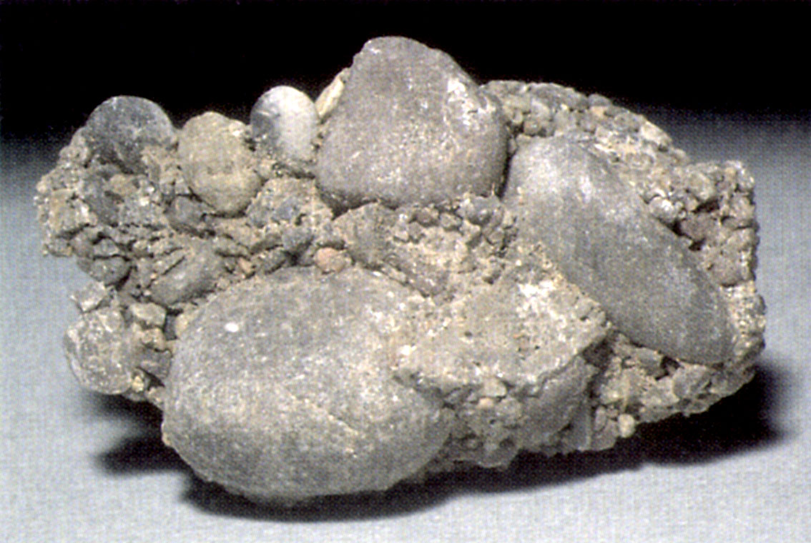
Conglomerate

Slide 8
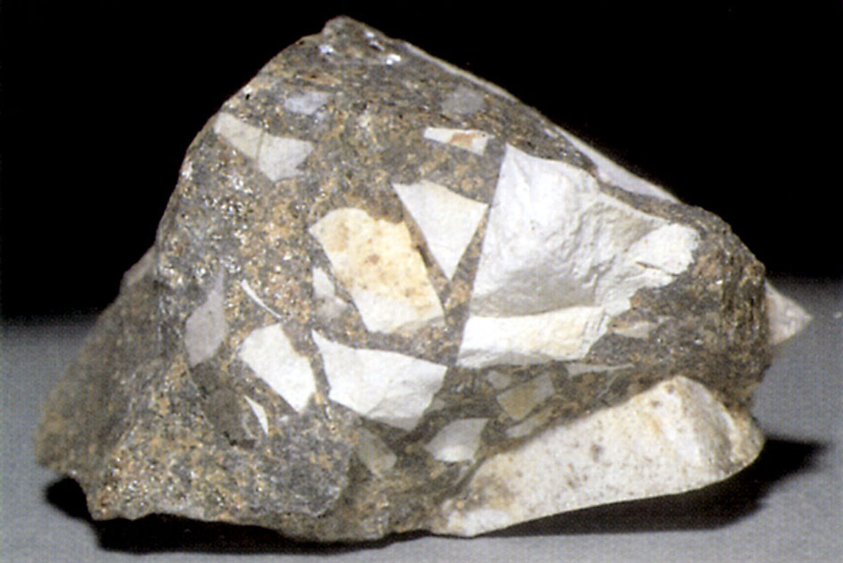
Breccia

Slide 9
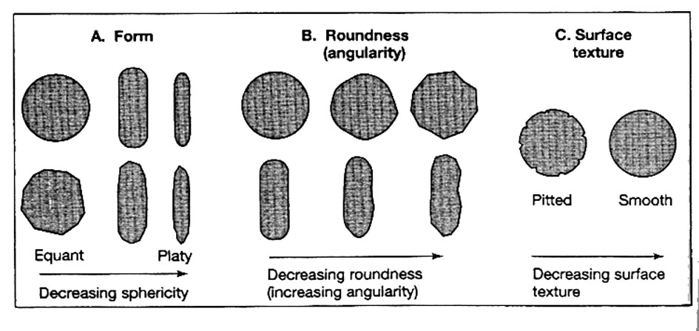
Shape and Roundness
The degree of abrasion of sedimentary particles

Slide 10
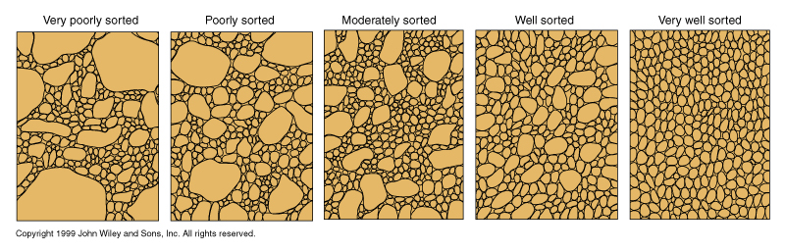
Sorting

Slide 11
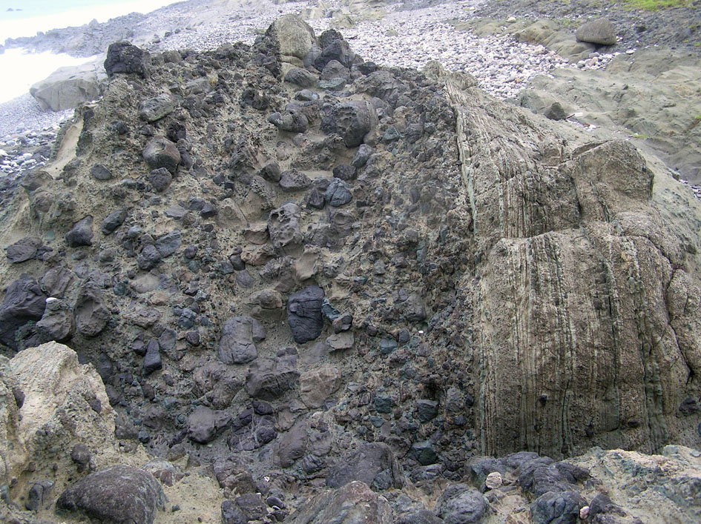

Slide 12
Mudrocks
Silt
Shale
Bedded silt or bedded shale
Laminated silt or laminated shale

Slide 13
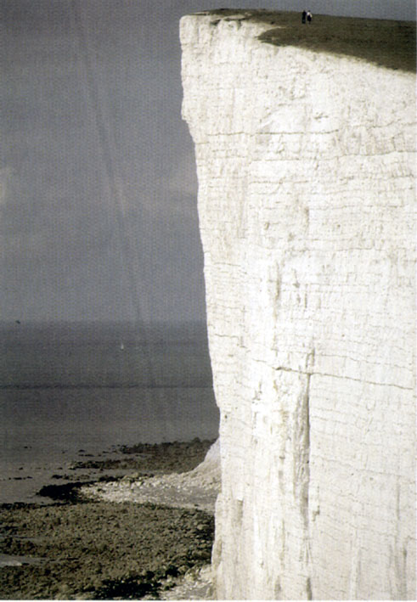
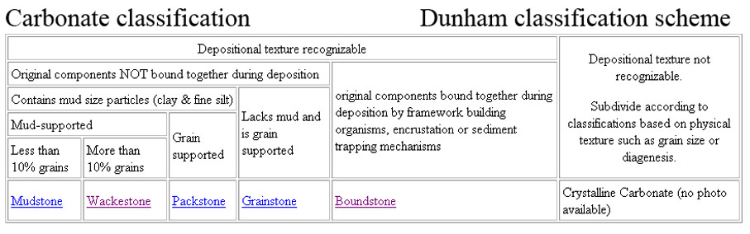
Carbonates
Chemical/Biochemical
Limestone
Dolomite

Slide 14
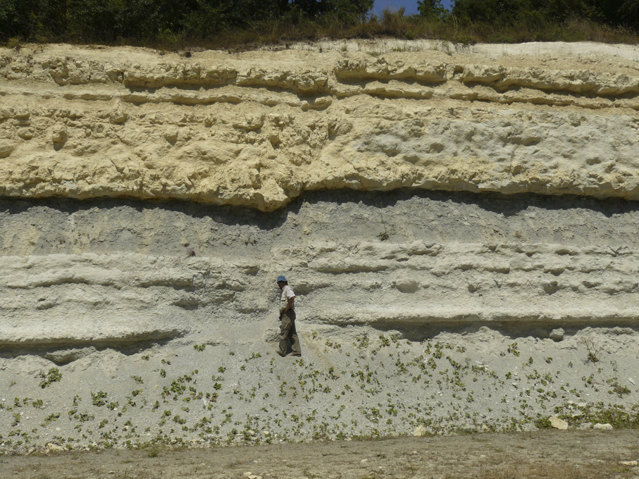

Slide 15
Chemical sedimentary rocks
Evaporites
Siliceous sedimentary rocks (cherts)
Phosphorites

Slide 16
Sedimentary structures
A geologic structure is a geometric feature in rock whose shape, form, and distribution can be described
Large scale feature of sedimentary rocks
Information on origin of rocks
Information on younging direction
Information on paleocurrent direction

Slide 17
Stratification and bedforms | Bedding-plane markings
Bedding and lamination Laminated bedding Graded bedding Massive (structureless) bedding Bedforms Ripple Dunes Antidunes Bedforms Cross-bedding Ripple cross-lamination Flaser and lenticular bedding Hummocky cross-stratification Irregular stratification Convolute bedding and lamination Flame structures Channels Scour-and-fill structures | Groove cast; striations, bounce, brush, prod, and roll mark Flute cast Parting lineation Load cast Track, trails burrows Mudcracks and syneresis cracks Pits and small impressions Rill and swash marks Other structures Sedimentary sills and dykes

Slide 18
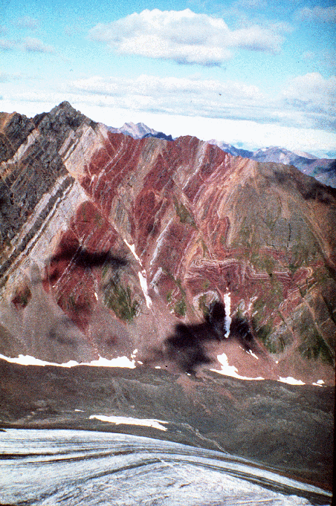
Beds, or strata are tabular or lenticular layers of sedimentary rock that have lithologic, textural, or structural unity that clear distinguishes them from layers above and bellow

Slide 19
Description of bedding
Thick beds
Medium beds
Thin beds
Thinly laminated beds
Rhythmic beds

Slide 20
Bedding planes
Groups of similar beds or cross beds are called bedsets
Bed termination

Slide 21
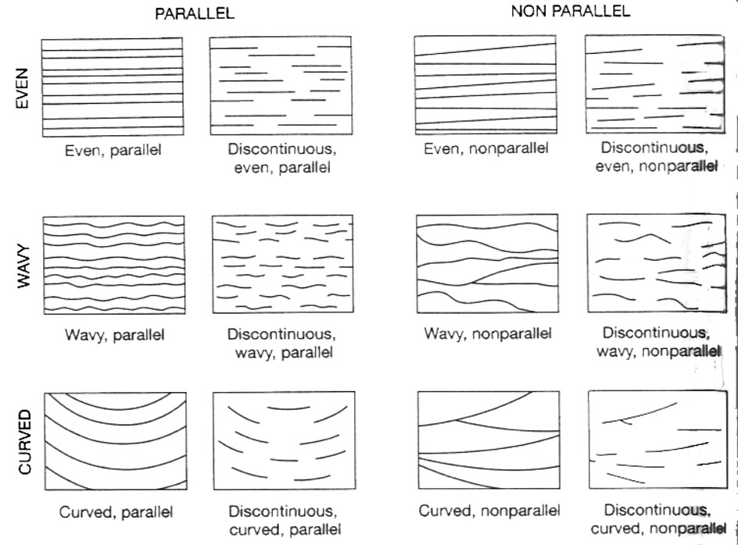
Bedding

Slide 22
Three mechanisms are responsible for the formation of bedding planes
1)
2)
3)
Bed load
Stream load

Slide 23
Lack of bedding means: (1) bioturbation (2) deposition from highly concentrated stream load (3) rapid deposition from suspension.

Slide 24
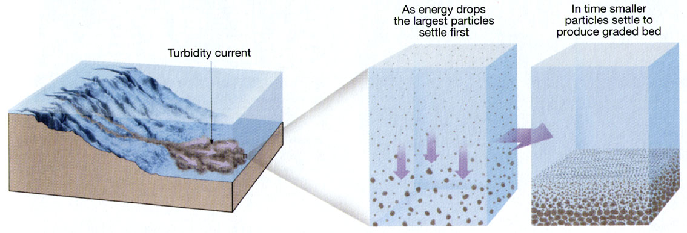
Graded bedding
Commonly produced by turbidity currents
Turbidity current is poorly sorted material suspended in water..

Slide 25
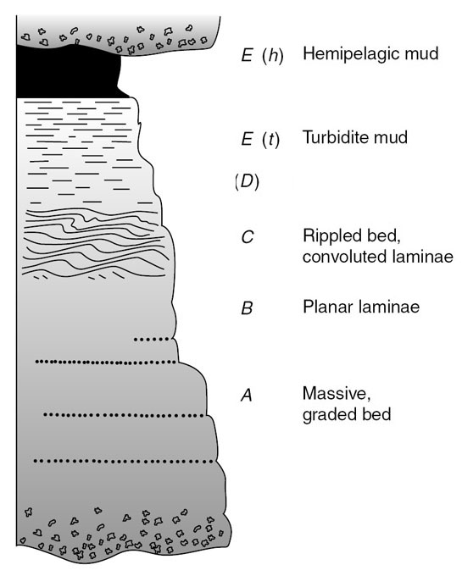
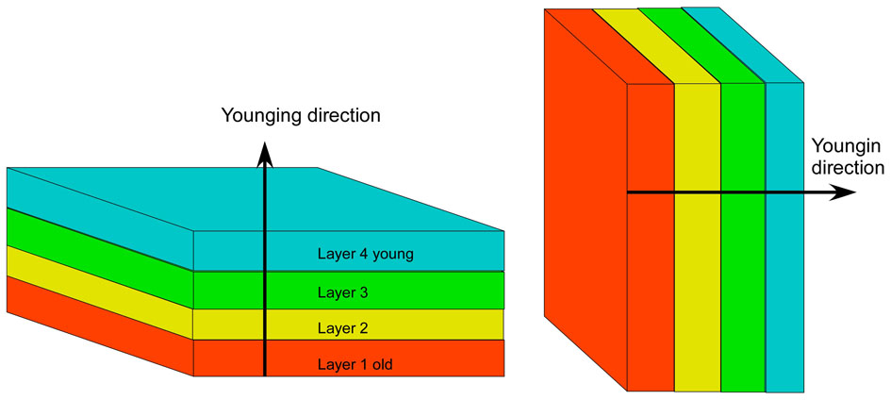
Graded bedding
Younging direction
Younging direction

Slide 26
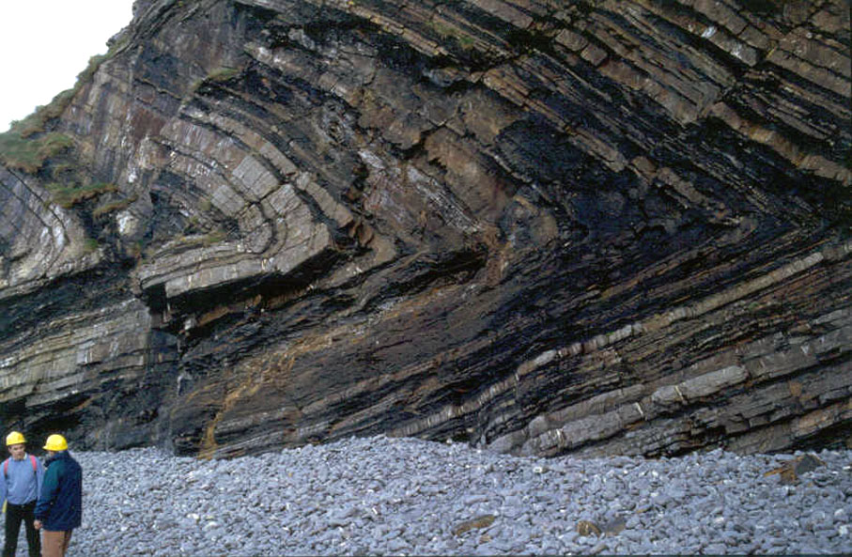

Slide 27
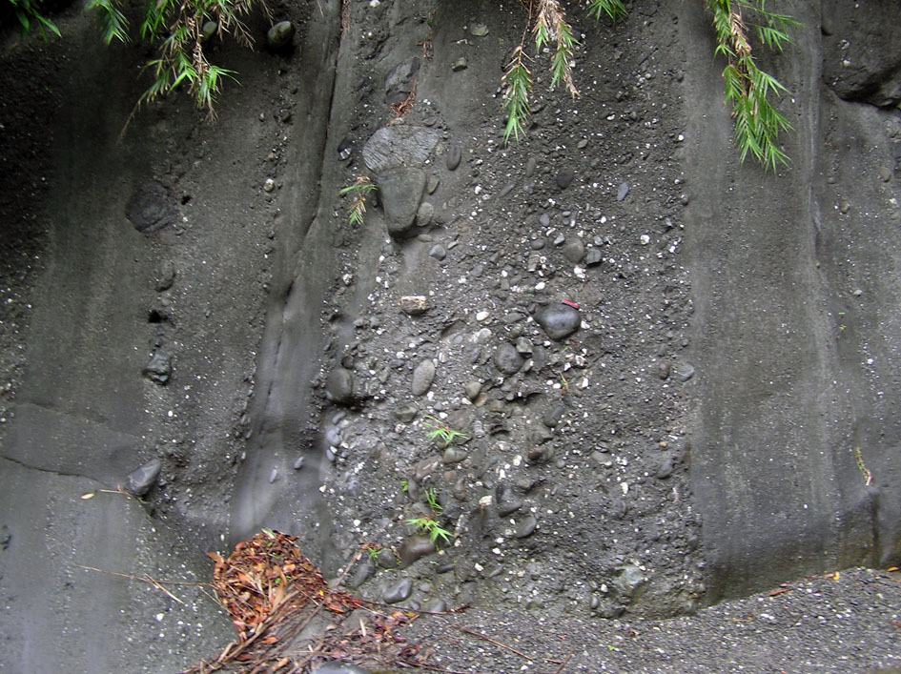
Inverse grading

Slide 28
Bed and bedforms
Bed in stratigraphy
Bed in sedimentology
Bed form or bedform

Slide 29
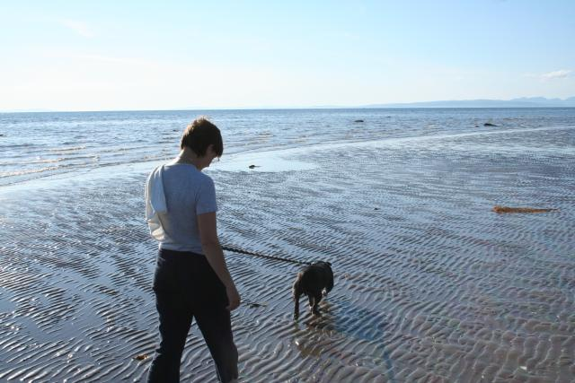

Slide 30
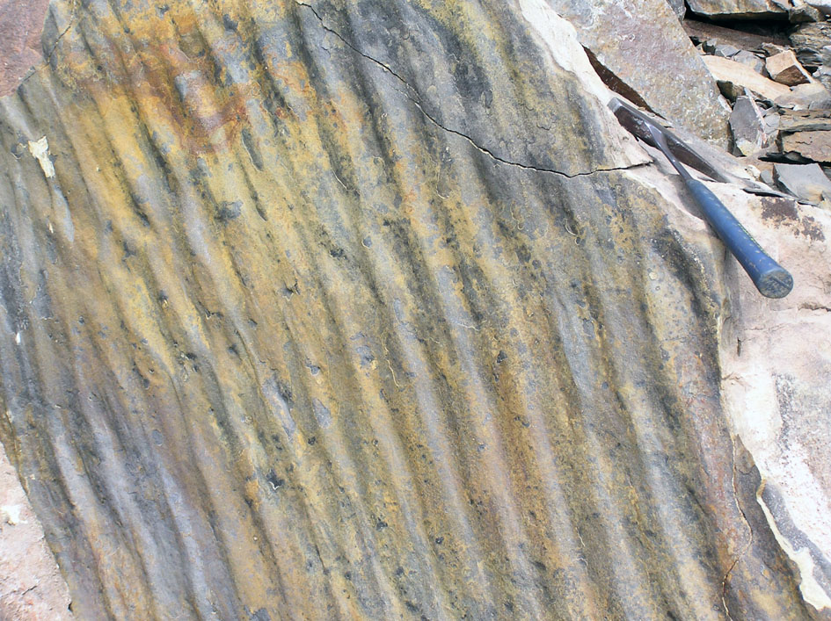

Slide 31
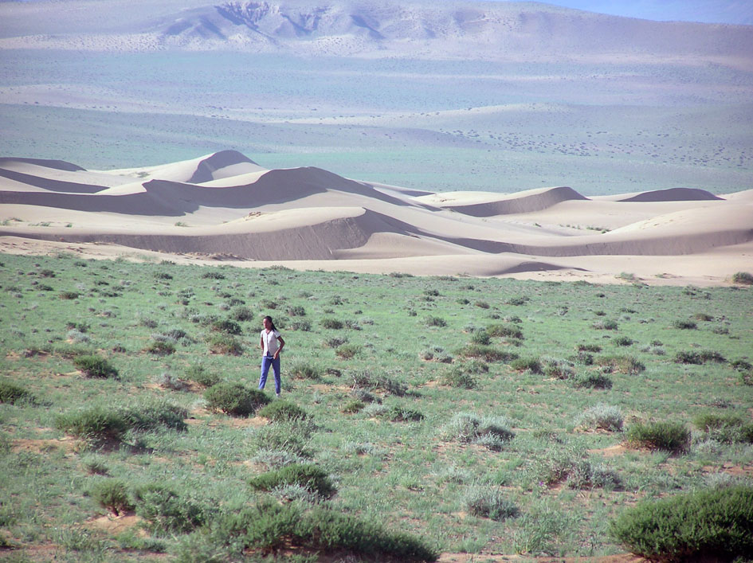

Slide 32
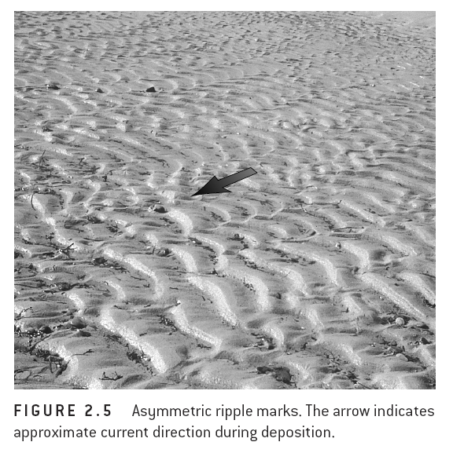
Ripple marks

Slide 33
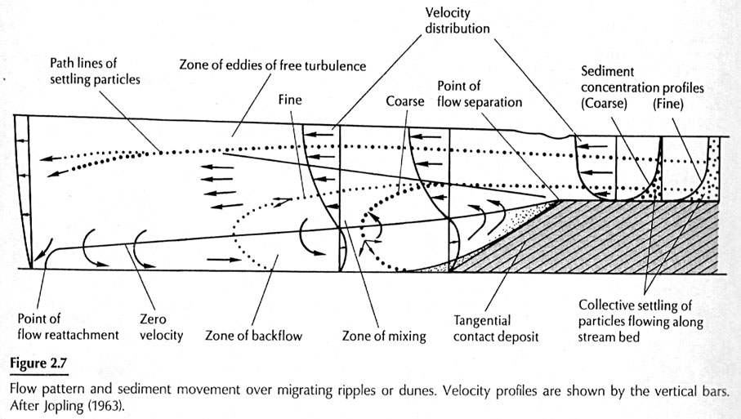
Bedforms

Slide 34
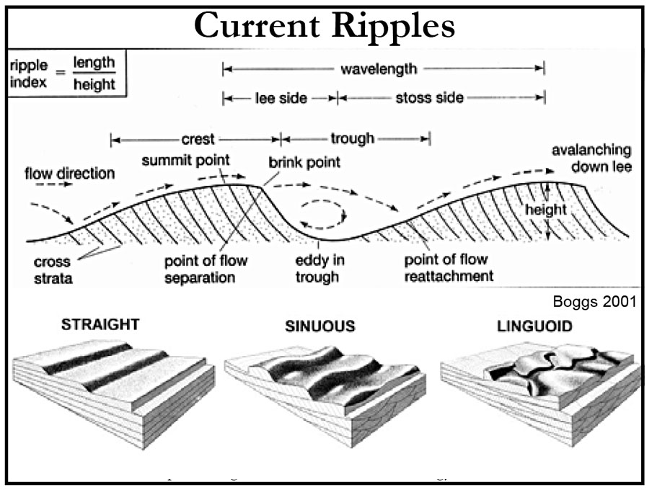

Slide 35
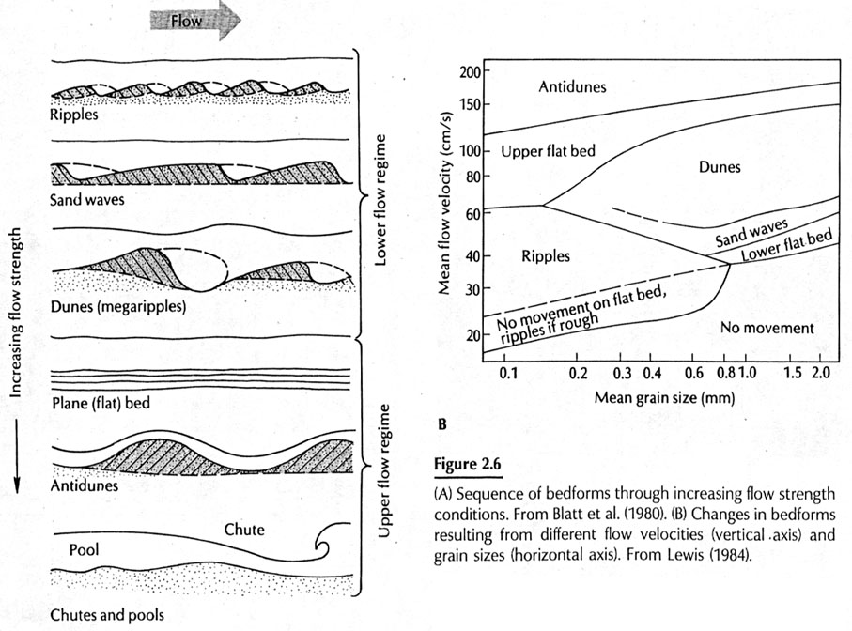

Slide 36
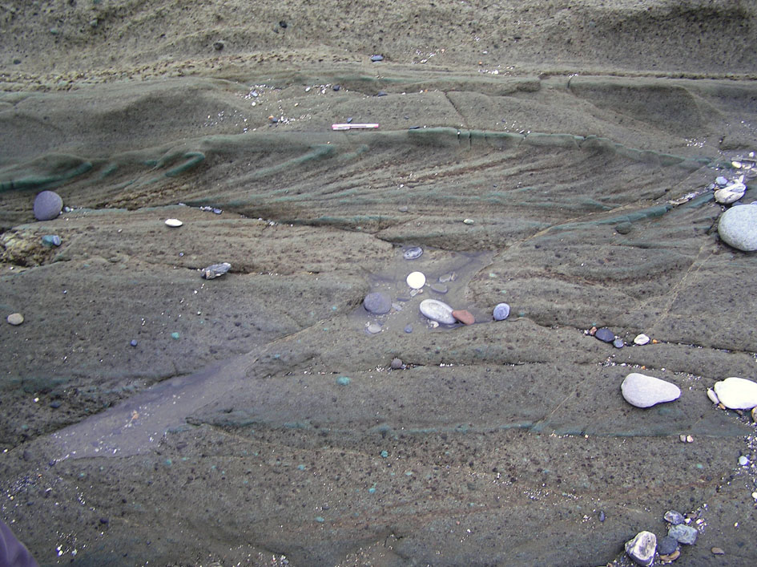

Slide 37
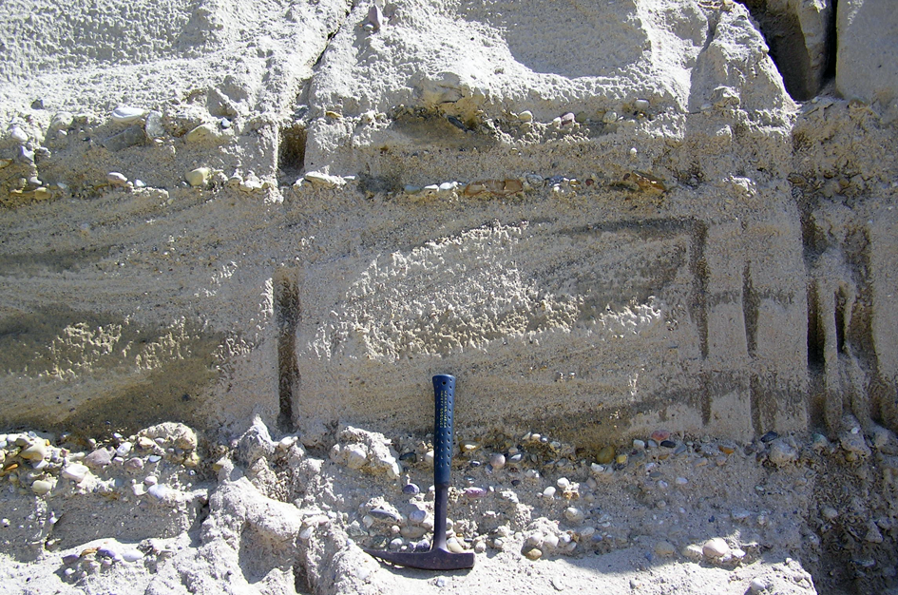
Cross beds in fluvial deposits of the Manzurka Formation, Baikal Lake
Erosion of topset

Slide 38
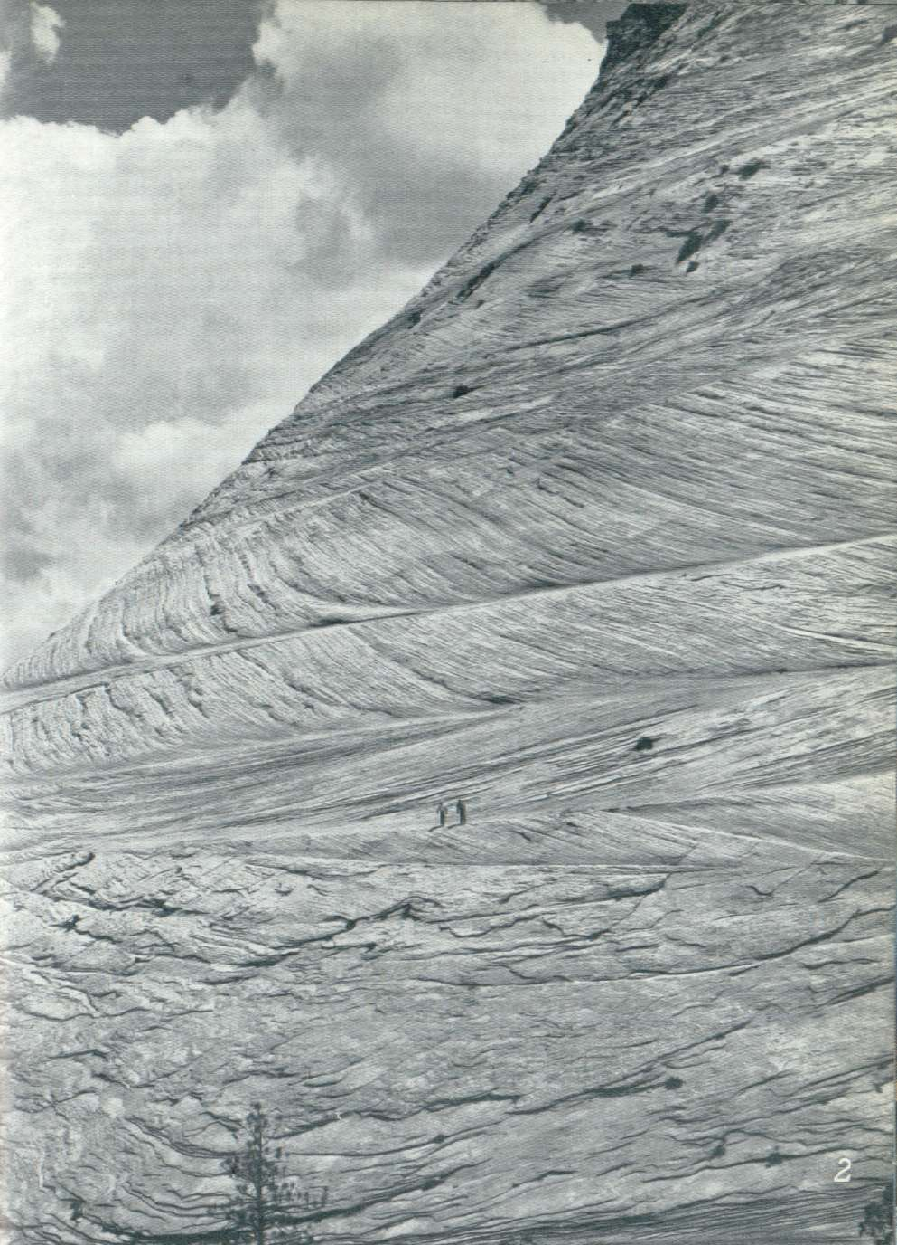
Cross stratification

Slide 39
Irregular stratification
Convolute folds
Load casts
Flame structures
Channels

Slide 40
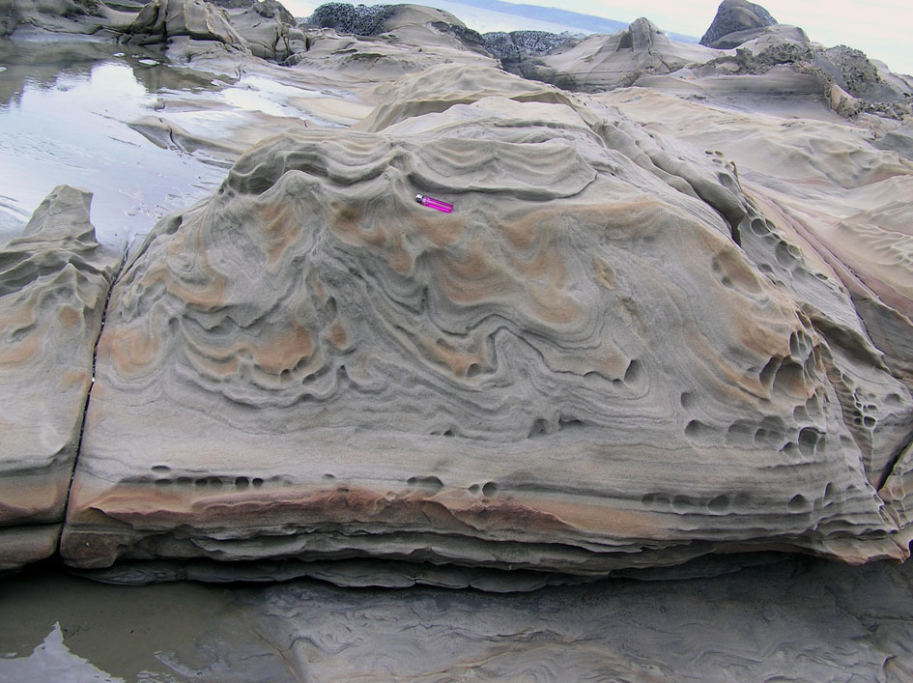
Convolute folds

Slide 41
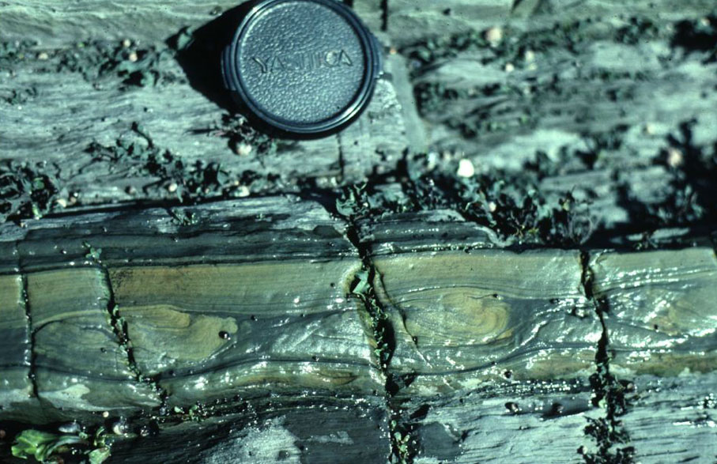
Convolute lamination

Slide 42
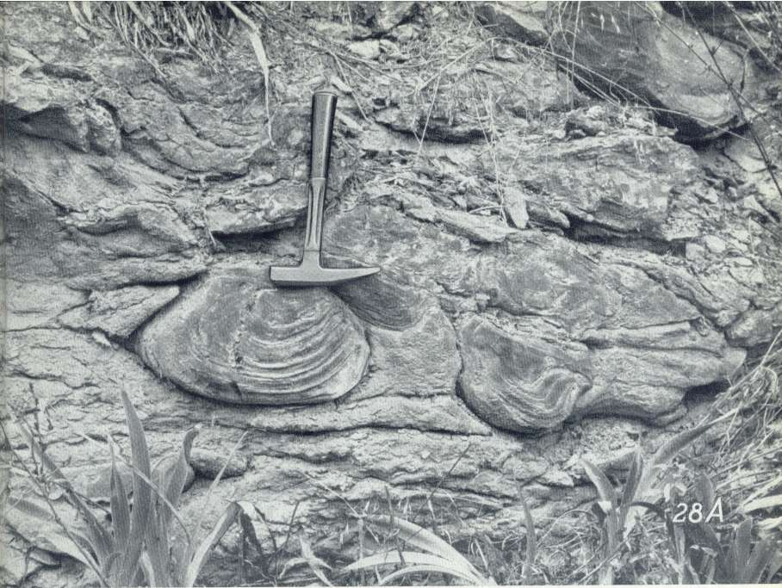
Load casts

Slide 43
Bedding plane structures
Groove cast; striations, bounce, brush, prod, and roll mark
Flute cast
Parting lineation
Track, trails burrows
Mudcracks and syneresis cracks

Slide 44
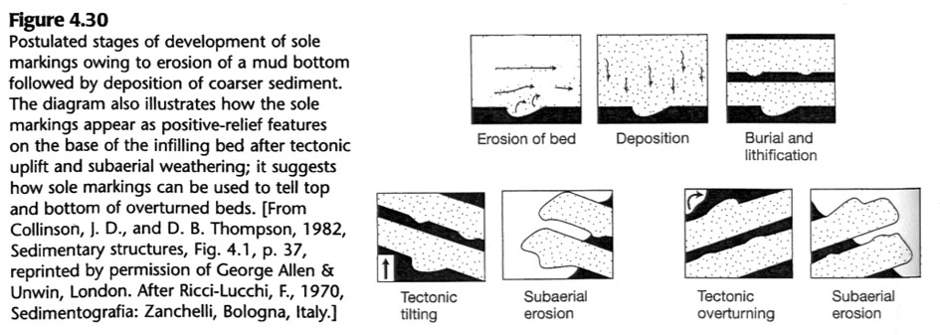
Bedding plane structures

Slide 45
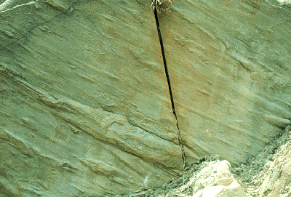
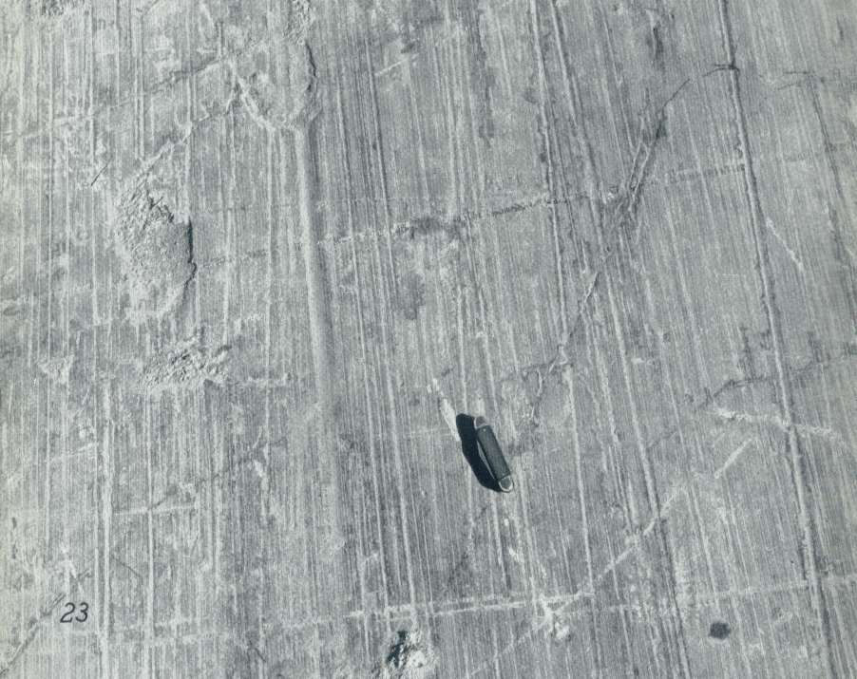
Grooves (Oluk yapıları)
Striations
(Buzul kertikleri)

Slide 46
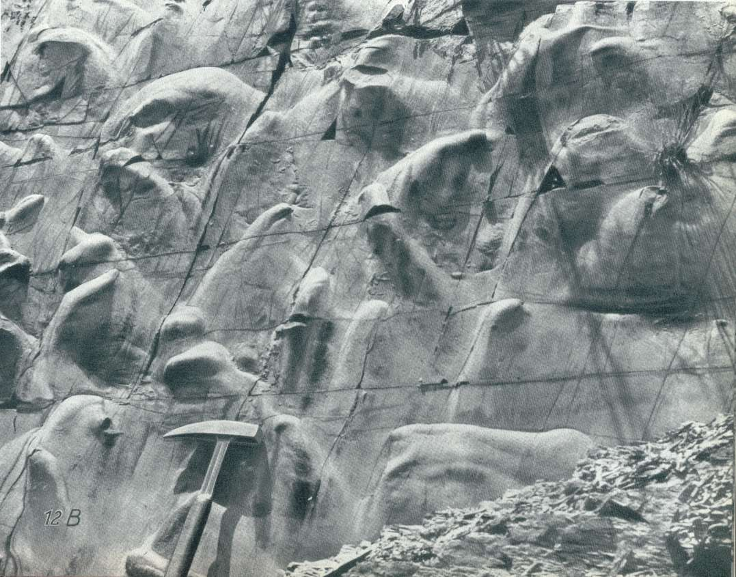
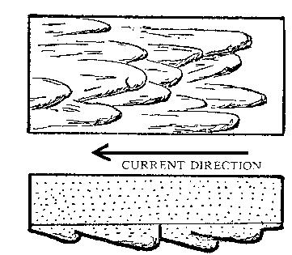
Kaval yapıları (flute casts). Akıntı yönü yukardan aşağıya.

Slide 47
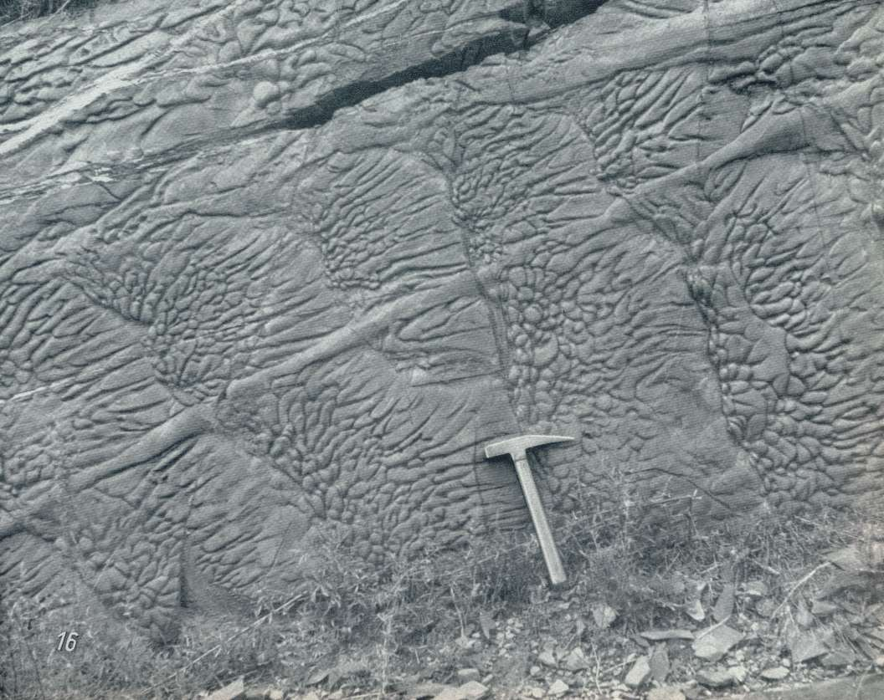
Flute marks
Load casts
Groove casts

Slide 48
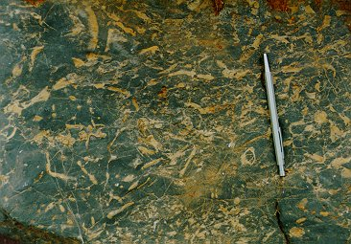
Biogenic sedimentary structures

Slide 49
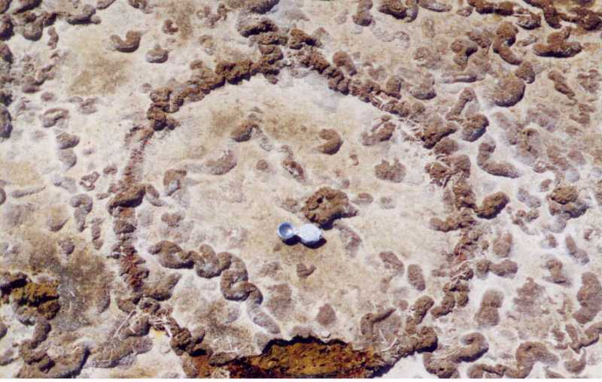
Biogenic structures

Slide 50
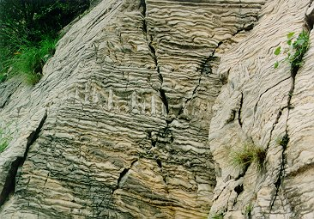

Slide 51
